Slide 1

Welcome to the WSLC Workforce Board
Labor Members Roundtable!
January 2022

Slide 2
Code of Conduct
This organization is committed to building an inclusive labor movement that promotes the safety and well-being of all working people. Harassment in any form is not acceptable. We have adopted a code of conduct and expect everyone to abide by it. We ask you to put into action our shared values of equity and equality and conduct yourselves in this meeting consistent with those values. We have designated the individuals listed below as the first point of contact for anyone who feels they have experienced discriminatory, harassing or otherwise unacceptable behavior, and we urge you to contact them if you have any concerns.
We take reports of harassment and discrimination seriously and commit to contacting you in a timely manner and clearly communicating if and how information will be shared after receiving a complaint. WSLC does not tolerate retaliation against people who have made complaints or who participate in an investigation.
Please contact designees Kasi (206.486.0451) or Joe Kendo (206.747.8279) or with any questions or concerns.

Slide 3
Tribal Land Acknowledgment
We would like to acknowledge that the WSLC Olympia office is on the traditional land of the first people of Olympia, the Cowlitz, Nisqually and Squaxin people past and present.
We honor with gratitude the land, the Cowlitz, Nisqually, Squaxin Tribes and all Coast Salish peoples and their descendants.
We invite you to join us in the continued learning, decolonization and acknowledgment of the historical violence of forced, unpaid labor on stolen land.

Slide 4
Eastern WA: Rachel McAloon 360-515-1335 Rmcaloon@wslc.org Southwest & Olympic: Chelsea Mason-Placek 253-973-3324 Cmasonplacek@wslc.org King County & Northwest: Emmanuel Flores 360-561-4657 Eflores@wslc.org Rmcaloon@wslrg
WSLC Workforce Development Department
Direct Worker Support
Labor Liaisons to the Workforce System
Workforce System Liaison to Unions
Layoff Aversion
Job Creation
We are here to serve you – let us be your partner in Workforce Development, because a skilled workforce works for everyone.
https://www.wslc.org/workforce-development/
https://www.wslc.org/workforce-development/

Slide 5
Donna Mack
Rapid Response

Slide 6
The Power of Rapid Response / WIOA
Laid Off Workers:
Introduction to Unemployment Insurance
Immediate aid to companies and affected workers at the work site – in person or virtually.
Assist dislocated workers in obtaining reemployment as soon as possible through their local WorkSource
Job Search
Training Options
Self-Employment
Introduction to Trade Act (if applicable)
Employers:
Avoid Future Layoffs
Incumbent Worker Training, Upskilling
Recruitment and Retention – job fairs, WS, Upskilling, etc

Slide 7
Collaborate
Coordinated team
LWDB – typically Business Services, organizes and directs Rapid Response event(s).
WorkSource (Wagner Peyser, Dislocated Worker program and Unemployment), Community college, WA State Labor Council, TAA (if applicable) and other resources participate.
Statewide Rapid Response Team:
Made up of ESD Rapid Response, ESD DW, and ESD TAA; Washington State Labor Council Workforce Development Managers; and Washington Workforce Association.
offers convening, technical assistance, statewide collaboration.
Currently working with LWDBs across the state to organize and present Rapid Response events to the 800+ all virtual non-perm workers separating from ESD

Slide 8
Labor Involvement
WSLC – staff and attend RR events, regardless if workers are represented or not
Transition Center for large layoffs
Shop Stewards to reach out and spread the word for Rapid Response and Trade
Peer Workers
Apprenticeship and training for re-employment
Sector assistance

Slide 9
Rapid Response as Transition Management
Saving Jobs: Layoff Aversion, Succession Planning, Incumbent Worker Training, ESOPs & Pre-feasibility Studies
Response: Employer Contact, Service Planning, Employee Meeting, On-Site Services…
Recovery: One-Stop Center, UI, Training, TAA, Career Counseling, Peer Support …
Reemployment: Job Fairs, OJT, Direct Placement

Slide 10
Resources and Contact Info
Donna Mack
Employment Security Department
360.628.2536
Donna.mack@esd.wa.gov
For more information, see DOLETA Rapid Response Services for Workers

Slide 11
Katherine Lechner
The Workforce Innovation & Opportunity Act
(WIOA)

Slide 12
WIOA Overview The Workforce Innovation & Opportunity Act
WIOA Titles & Programs
Title I: Workforce Development Activities
Youth, Adult, Dislocated Worker, Rapid Response, and others
Title II: Adult Education and Literacy
Adult Basic Education
Title III: Amendments to the Wagner-Peyser Act
Employment Service, Labor Market Information
Title IV: Amendments to the Rehabilitation Act
Vocational Rehabilitation, Independent Living, Limitations on Subminimum Wage

Slide 13
WIOA Overview The Workforce Innovation & Opportunity Act
Title I Career Services
Three types:
Basic
Individualized
Follow-up
Individualized services are based on unique employment needs
Includes:
Informational and referral services
Workshops and career planning
Job search and placement
Assessments
Workforce preparation
Internships and work experiences

Slide 14
WIOA Overview The Workforce Innovation & Opportunity Act
Title I Training Services
Determined on a case-by-case basis per WIOA criteria
Includes Individualized Training Accounts (ITAs)
Must maximize informed customer choice in selecting a training provider
Includes:
Registered apprenticeship
Occupational skills training
On-the-job training
Entrepreneurial training
Adult education and literacy
Customized training

Slide 15
WIOA Overview The Workforce Innovation & Opportunity Act
Title I Supportive Services
Coordination and provision determined by WDC policy
Supportive services can only be provided when:
An individual is participating in career or training services
Supports cannot be obtained via other programs
Supports are necessary to participate in career or training services

Slide 16
Resources and Contact Info
Katherine Lechner
Employment Security Department
360.878.0712
Katherine.Lechner@esd.wa.gov
Training and Employment Guidance Letter
TEGL_19-16.pdf (doleta.gov)

Slide 17
Michelle Griffith
Trade Adjustment Assistance
(TAA)

Slide 18
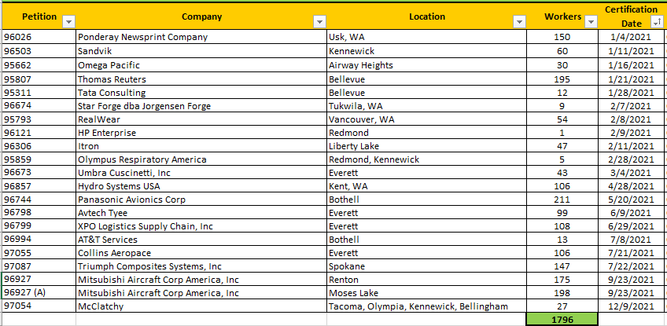
TAA Program Overview
TAA is a federal program funded by Department of Labor and operated by ESD.
Mission: to return trade impacted workers to suitable employment as quickly as possible.
Trade Act case managers are strategically positioned throughout the state based on activity with TAA certifications.
Dedicated TAA Outreach Specialist and WSLC work in partnership to educate workers and employers about TAA program benefits.
During the 2021 calendar year, there were 20 TAA certifications in Washington, resulting in approximately 1800 impacted workers being potentially eligible for TAA services.

Slide 19
TAA Snapshot December 2021
1168
Active TAA Participants Statewide
74%
Attending Training
59%
Co-enrolled in WIOA Dislocated Worker and TAA Program
TAA
84%
Training Completion Rate
Types of Training
Classroom & Work-Based Learning
What else does TAA offer?
Job Search & Relocation

Slide 20
Resources and Contact Info
Michelle Griffith
TAA Program Operator
Employment Security Department
360.915.2723
Michelle.Griffith@esd.wa.gov
For more information, see:
US Dept of Labor Employment and Training Administration
Trade Adjustment Act on ESD.WA.GOV

